Slide 1


DELEGATES AND EVENTS
Sampath Kumar Bingi
AUG, 2018

Slide 2
Agenda
Overview
Common Business Scenarios
Creation of Delegates
Creation of Events
In-Build Delegates

Slide 3
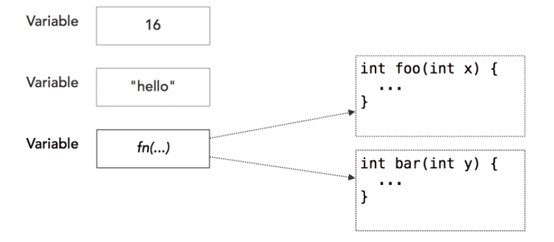
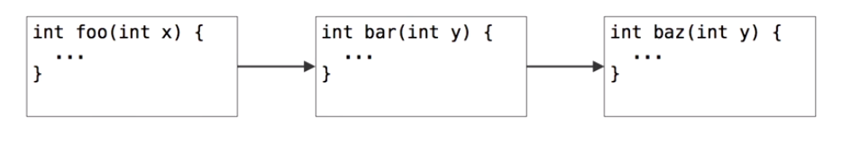
Overview of Delegates
Delegates: Placeholders for functions
Delegates can be dynamically chained together
Notes:
What is a delegate
A delegate is a type safe function pointer.
That is, it holds a reference(pointer) to a function
The signature of the delegate must match the signature of the function, the delegate points to, otherwise you get a compiler error.
This is the reason delegates are called as type safe function pointers.
A delegate is similar to a class. You can create an instance of it, and when you do so, you pass in the function name as a parameter to the delegate constructor, and it is to this function the delegate will point to.

Slide 4
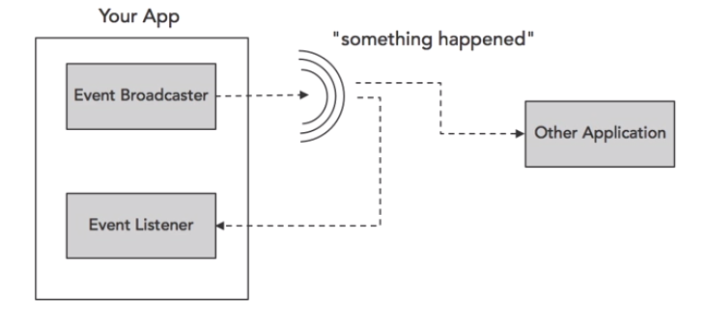
Overview of Events
Used to broadcast and listen to messages

Slide 5
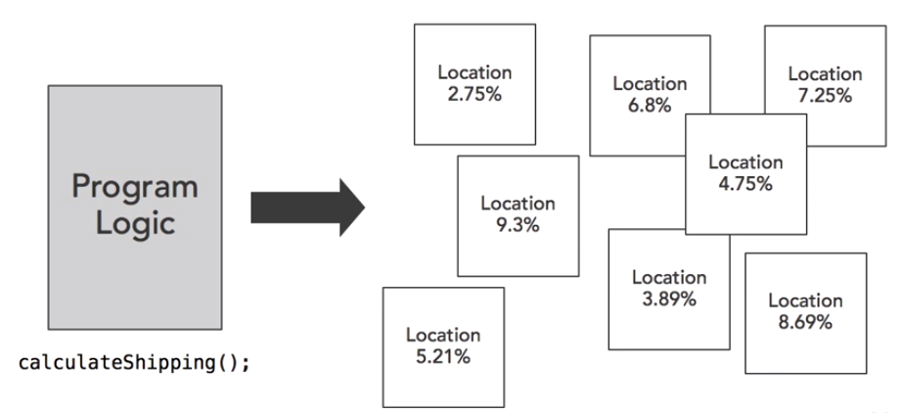
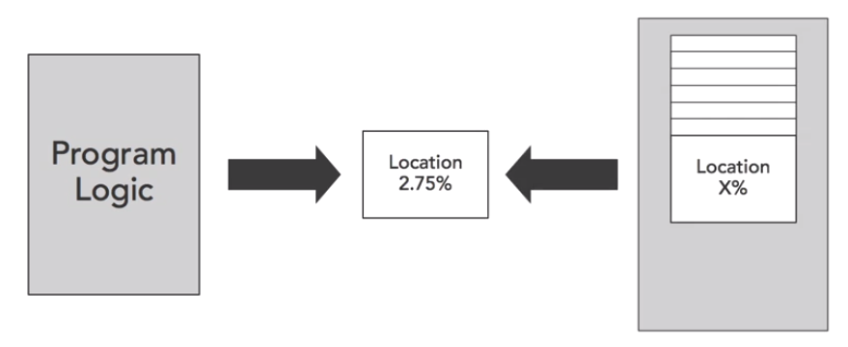
Common business scenarios
Shipping Company which ships items to multiple locations and have to calculate fee as per location

Slide 6
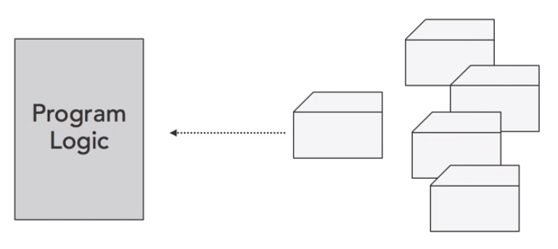
Common business scenarios
Identify the change of contents in folder
Identify the change in user input or button click in web dev

Slide 7
Delegates
Notes:
What is a delegate
A delegate is a type safe function pointer.
That is, it holds a reference(pointer) to a function
The signature of the delegate must match the signature of the function, the delegate points to, otherwise you get a compiler error.
This is the reason delegates are called as type safe function pointers.
A delegate is similar to a class. You can create an instance of it, and when you do so, you pass in the function name as a parameter to the delegate constructor, and it is to this function the delegate will point to.

Slide 8
What is callback?
Task: copy file with process indicator
Solution: create interface IProgressIndicator
public interface IProgressIndicator { void Progress(string message, int progressPercentage); }
public class WriteLogToConsole : IProgressIndicator { public void Progress(string message, int progressPercentage) { Console.WriteLine("{0} ({1}%) - {2}", DateTime.UtcNow, progressPercentage, message); } }

Slide 9
What is callback?
static public void Copy(string srcPath, string dstPath, IProgressIndicator progressIndicator) { var fi = new FileInfo(srcPath); var srcFile = new FileStream(srcPath, FileMode.Open); var dstFile = new FileStream(dstPath, FileMode.CreateNew); byte[] buffer = new byte[bufferSize]; int readedSize; int step = 0; progressIndicator.Progress("Start copy", 0); do { readedSize = srcFile.Read(buffer, 0, bufferSize); dstFile.Write(buffer, 0, bufferSize); step++; progressIndicator.Progress("Progress copy", (int) fi.Length / (step * readedSize)); } while (readedSize != 0); progressIndicator.Progress("Finish copy", 100); }

Slide 10
From interface to delegate
Interface disadvantages
Complex (we need create class for realization)
As alternative – use delegates
interface ITransformer { int Transform(int x); }
delegate int Transform(int x);

Slide 11
Use delegates
delegate int Transform(int x);
[TestClass] public class SimpleDelegateSample { static int Square(int x) { return x * x; } static int Add(int x) { return x + x; } static int DoubleTransform(int x, Transform trans) { return trans(trans(x)); } [TestMethod] public void TransformTest() { Transform t = Square; // Create delegate instance
var result = t(3); // Invoke delegate var result2 = t.Invoke(5); // Invoke delegate
var result3 = DoubleTransform(6, Add); // Delegate as parameter
Console.WriteLine("{0} {1} {2}", result, result2, result3); } }

Slide 12
Multicast delegates
delegate void ProgressDelegate(string message, int progressPercentage); void WriteProgressToFile(string message, int progressPercentage) { File.AppendAllText(/* */); } void WriteProgressToConsole(string message, int progressPercentage) { Console.WriteLine(/* */); } void ProgressEmulator(ProgressDelegate progress) { int stepCount = (int)(new Random(new TimeSpan().Seconds).NextDouble() * 10); progress("Start", 0); for (int step = 0; step < stepCount; step++) { progress("Progress", (int)(step * 100 / stepCount)); System.Threading.Thread.Sleep(100); } progress("Finish", 100); }
ProgressDelegate p = null; p += WriteProgressToConsole; p += WriteProgressToFile; ProgressEmulator(p);
Notes:
Multicast delegate is an extension of normal delegate. It helps you to point more than one method at a single moment of time.

Slide 13
Multicast delegates
delegate int ValueDelegate();
Disadvantages
Only one (last) return value
Break execution all delegates if one throw exception
ValueDelegate d = null; d += A1; d += A2; d += A3; Console.WriteLine(d());
ValueDelegate d = null; d += A1; d += A2; d += A3; foreach (ValueDelegate t in d.GetInvocationList()) { Console.WriteLine(t()); }

Slide 14
Multicast delegates with ref
static void func1(int arg1, ref int arg2)
{
int result = arg1 + arg2;
arg2 += 20;
}
static void func2(int arg1, ref int arg2)
{
int result = arg1 * arg2;
}
Use ref variables to pass results from one delegate to other
int a = 10, b = 10;
MyDelegate f1 = func1;
MyDelegate f2 = func2;
MyDelegate combined = f1 + f2;
combined(a, ref b);

Slide 15
Anonymous delegates
delegate void WithoutReturn(int x);
delegate int WithReturn(int x);
WithoutReturn p = delegate (int x) { Console.WriteLine(x); }; WithReturn p2 = delegate (int x) { return x * x; };
Notes:
List.Find()

Slide 16
Static vs. Instance delegates
void InstanceDelegate() { this.Property = ""; } static void StaticDelegate() { // Can't call instance property }
public void CreateDelegateInInstanceMember() { MyDelegate p1 = InstanceDelegate; MyDelegate p2 = StaticDelegate; }
public static void CreateDelegateInStaticMember() { var t = new StaticVsInstance(); MyDelegate p1 = t.InstanceDelegate; MyDelegate p2 = StaticDelegate; }

Slide 17
When to use Delegates ?
Notes:
An eventing design pattern is used.
If the code doesn't need access to any other attributes or method of the class from which logic needs to be processed.
The caller has no need to access other properties, methods, or interfaces on the object implementing the method.
A class may need more than one implementation of the method.
There is a group of related methods that may be called.
A class only needs one implementation of the method.

Slide 18
Events
Notes:
C# provides event driven programming by adding support through Events.
It is a way to provide notifications to client when something happens to an object.
Events and Delegates are tightly coupled concept because event handling requires Delegate for the dispatch of Event.
Implementation of Event is a 3 step process.
Declare - public delegate void CallEveryOne()
Create - public Event CallEveryOne objEventCallEveryOne;
Call- objEventCallEveryOne;
Difference between Delegates and Events
When we create an Event, the client can only listen to the Event, where when we create a delegate, the client will get lot of control over application (He can add/remove methods in delegate.).

Slide 19
Introduction to Events
public class Worker { public delegate void ProgressDelegate(int percentComplete); public event ProgressDelegate Progress; public void DoWork() { for (int i = 0; i < 10; i++) { Progress(i * 10); System.Threading.Thread.Sleep(100); } } }
public void TestMethod1() { var worker = new Worker(); worker.Progress += worker_Progress; worker.DoWork(); } private void worker_Progress(int percentComplete) { Console.WriteLine(percentComplete); }
Notes:
Implementation of Event is a 3 step process.
Declare - public delegate void CallEveryOne()
Create - public Event CallEveryOne objEventCallEveryOne;
Call- objEventCallEveryOne;
Difference between Delegates and Events
When we create an Event, the client can only listen to the Event, where when we create a delegate, the client will get lot of control over application (He can add/remove methods in delegate.).

Slide 20
BCL recommendations for Events
public class WorkerProgressArgs { public int ProgressPercent { get; internal set; } } public event EventHandler<WorkerProgressArgs> Progress; protected virtual void OnProgress(WorkerProgressArgs args) { var tmp = Progress; if (tmp != null) tmp(this, args); } public void DoWork() { for (int i = 0; i < 10; i++) { OnProgress( new WorkerProgressArgs { ProgressPercent = i * 10 }); System.Threading.Thread.Sleep(100); } }
public void TestMethod1() { var worker = new BCLWorker(); worker.Progress += worker_Progress; worker.DoWork(); } private void worker_Progress(object sender,
BCLWorker.WorkerProgressArgs e) { Console.WriteLine(e.ProgressPercent); }

Slide 21
Event chaining and unchaining
MyClass obj = new MyClass();
// Connect multiple event handlers
obj.valueChanged += changeListener1;
obj.valueChanged += changeListener2;
// Use an anonymous delegate as the event handler
obj.valueChanged += delegate(string s) {
Console.WriteLine("This came from the anonymous handler!");
};
obj.objChanged += delegate(object sender, ObjChangeEventArgs e) {
Console.WriteLine("{0} had the '{1}' property changed", sender.GetType(), e.propChanged);
};

Slide 22
THANK YOU

